Slide 1
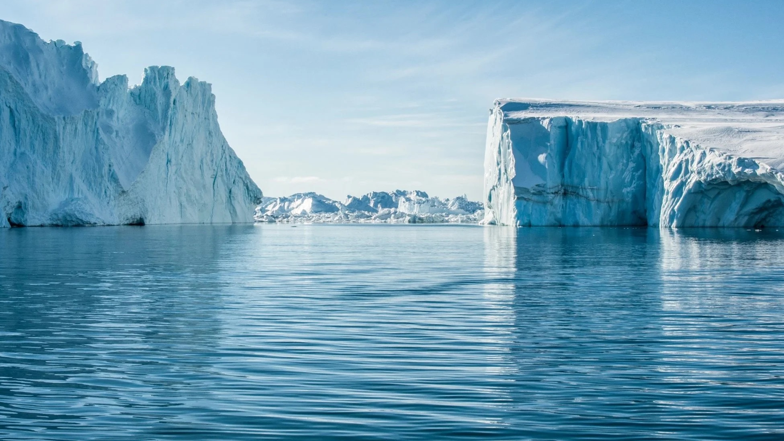
EXTREME ENVIRONMENTS: COLD REGION
GROUP 16

Slide 2
PRESENTATION OUTLINE
INTRODUCTION TO COLD REGION
GEOGRAPHY AND CHARACTERISTICS OF COLD REGIONS
EXAMPLES OF COLD REGION
FAUNA AND FLORA FOUND IN COLD REGIONS
HUMAN INHABITANTS IN COLD REGIONS
CONCLUSION

Slide 3
INTRODUCTION TO COLD REGION
N
A cold region is an area that is mostly found near or at the earth’s poles.
Cold regions are found to cover over 25% of the World’s land surface
They are found on rocky, mountainous or barren areas.
S

Slide 4
GEOGRAPHY OF COLD REGIONS
2 main factors account for regions to be cold on the earth. These are:
Altitude
Latitude

Slide 5
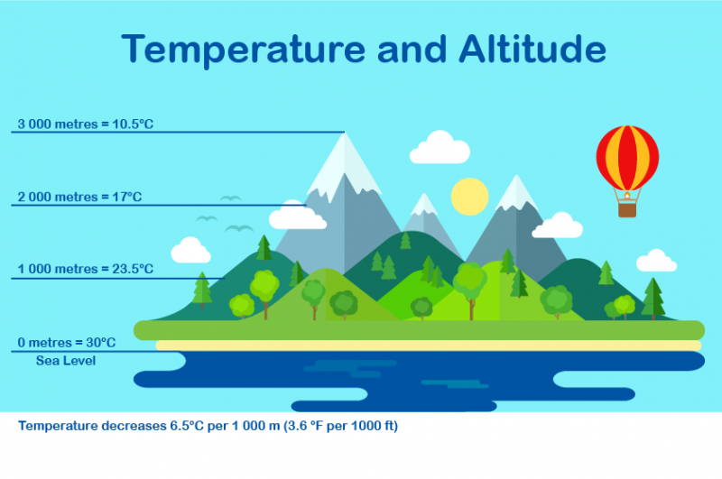
GEOGRAPHY OF COLD REGIONS: ALTITUDE
As altitude increases, there is a decrease in the level of temperature.

Slide 6
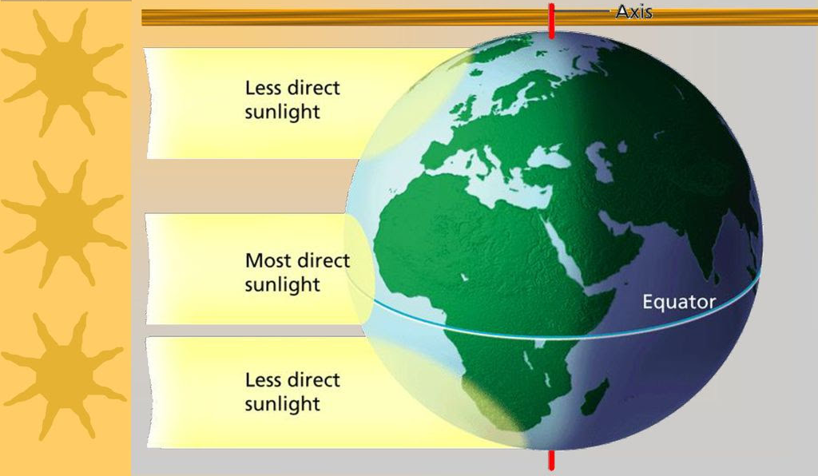
GEOGRAPHY OF COLD REGIONS: LATITUDE
N
Regions closer to the poles lack sufficient amount of sunlight.
This is because there is a decrease in the magnitude of the sun’s rays (Yung, 2007).
SUN
S

Slide 7
CHARACTERISTICS OF COLD REGIONS
CLIMATE
TEMPERATURE
SEASONS
RAINFALL / PRECIPITATION
SOIL
BIODIVERSITY

Slide 8
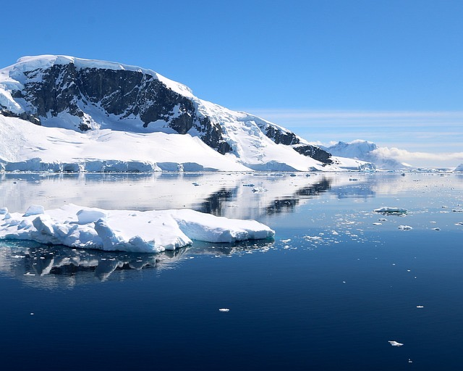
WHAT ARE SOME OF THE EXAMPLES OF COLD REGIONS?
POLAR REGIONS: also termed as frigid zones, surround the geographical poles of the earth (North and South poles). Arctic and Antarctic regions fall under the polar region.
Norway, Siberia, Denmark, Russia etc.

Slide 9
WHAT ARE SOME OF THE EXAMPLES OF COLD REGIONS?
TUNDRA: sometimes called cold desert, is a treeless region found mostly in the Arctic and on top of mountains, where the climate is cold and windy and rainfall is scant.
Alaska, Canada, Greenland, Iceland etc.
Some types are:
Arctic tundra
Alpine tundra
Antarctic tundra

Slide 10
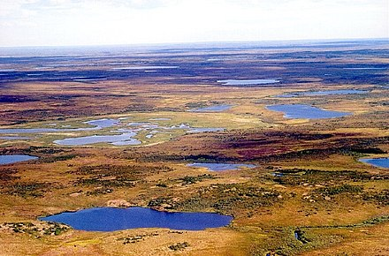
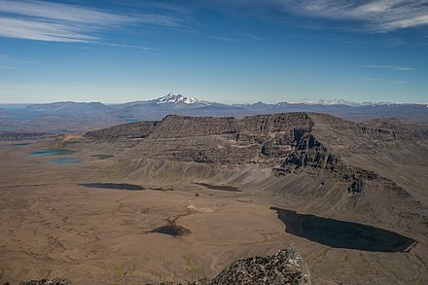
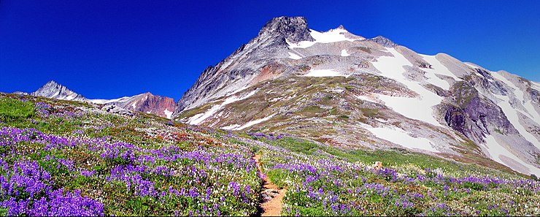
WHAT ARE SOME OF THE EXAMPLES OF COLD REGIONS?
Arctic tundra
Arctic tundra
Antarctic tundra
Alpine tundra

Slide 11
Characteristics of FAUNA IN COLD REGIONS
Thick insulating fur or feathers
Reduced body parts
Layered fat deposits
Hibernation

Slide 12
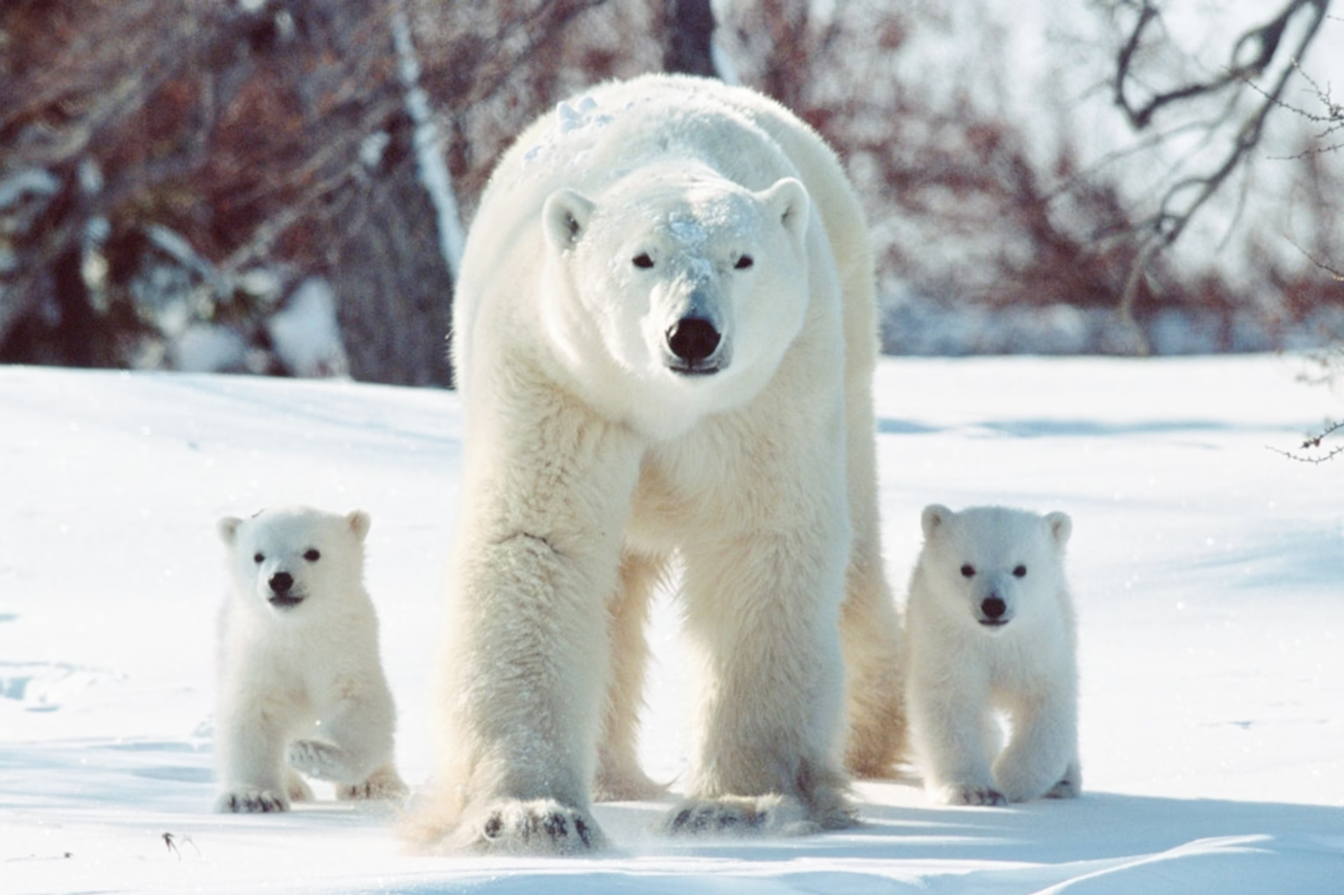
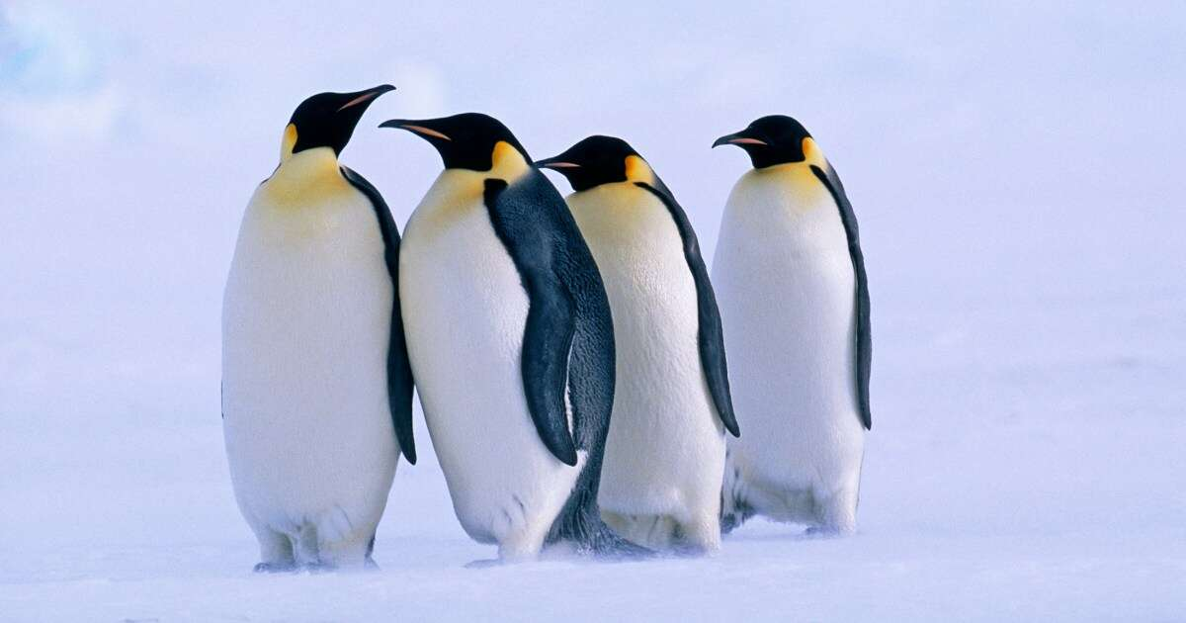

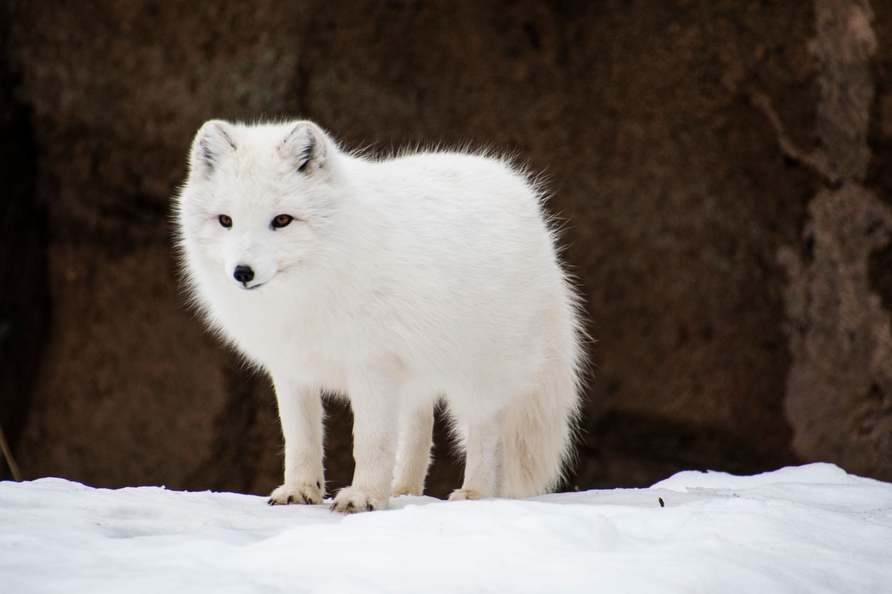
EXAMPLES of FAUNA IN COLD REGIONS
Polar bears
Penguins
Beluga whale
Arctic fox

Slide 13
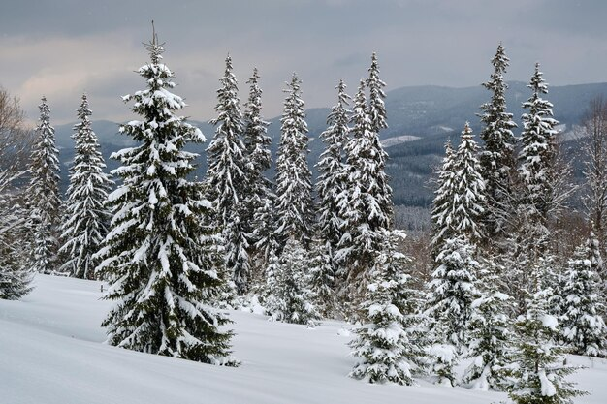
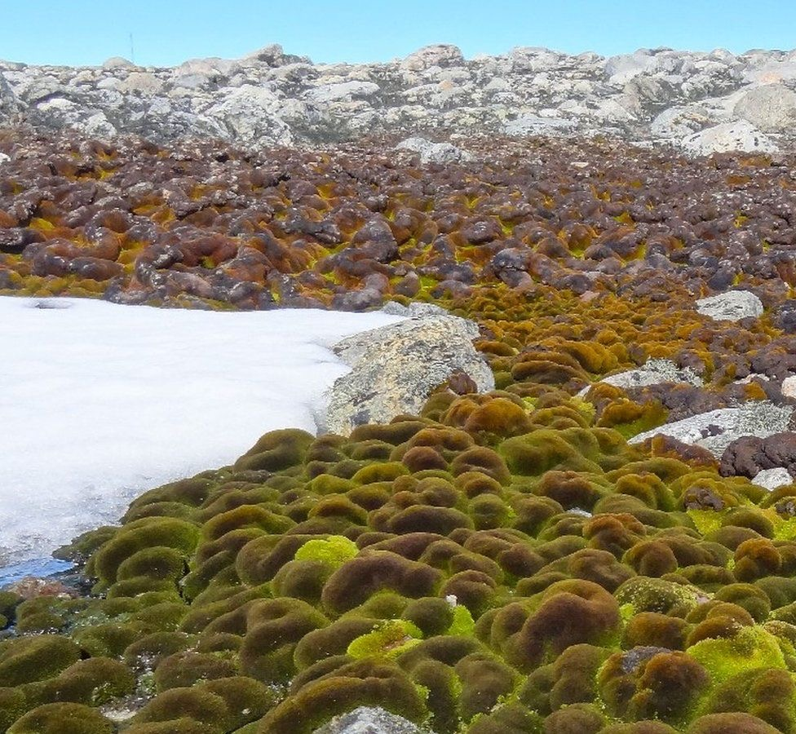
Characteristics of FLORA IN COLD REGIONS
Dormancy
Reduced surface area
Deep root systems
Compact growth forms
Deciduous
Conifers
Antartic moss

Slide 14


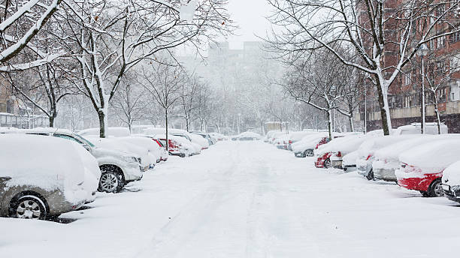
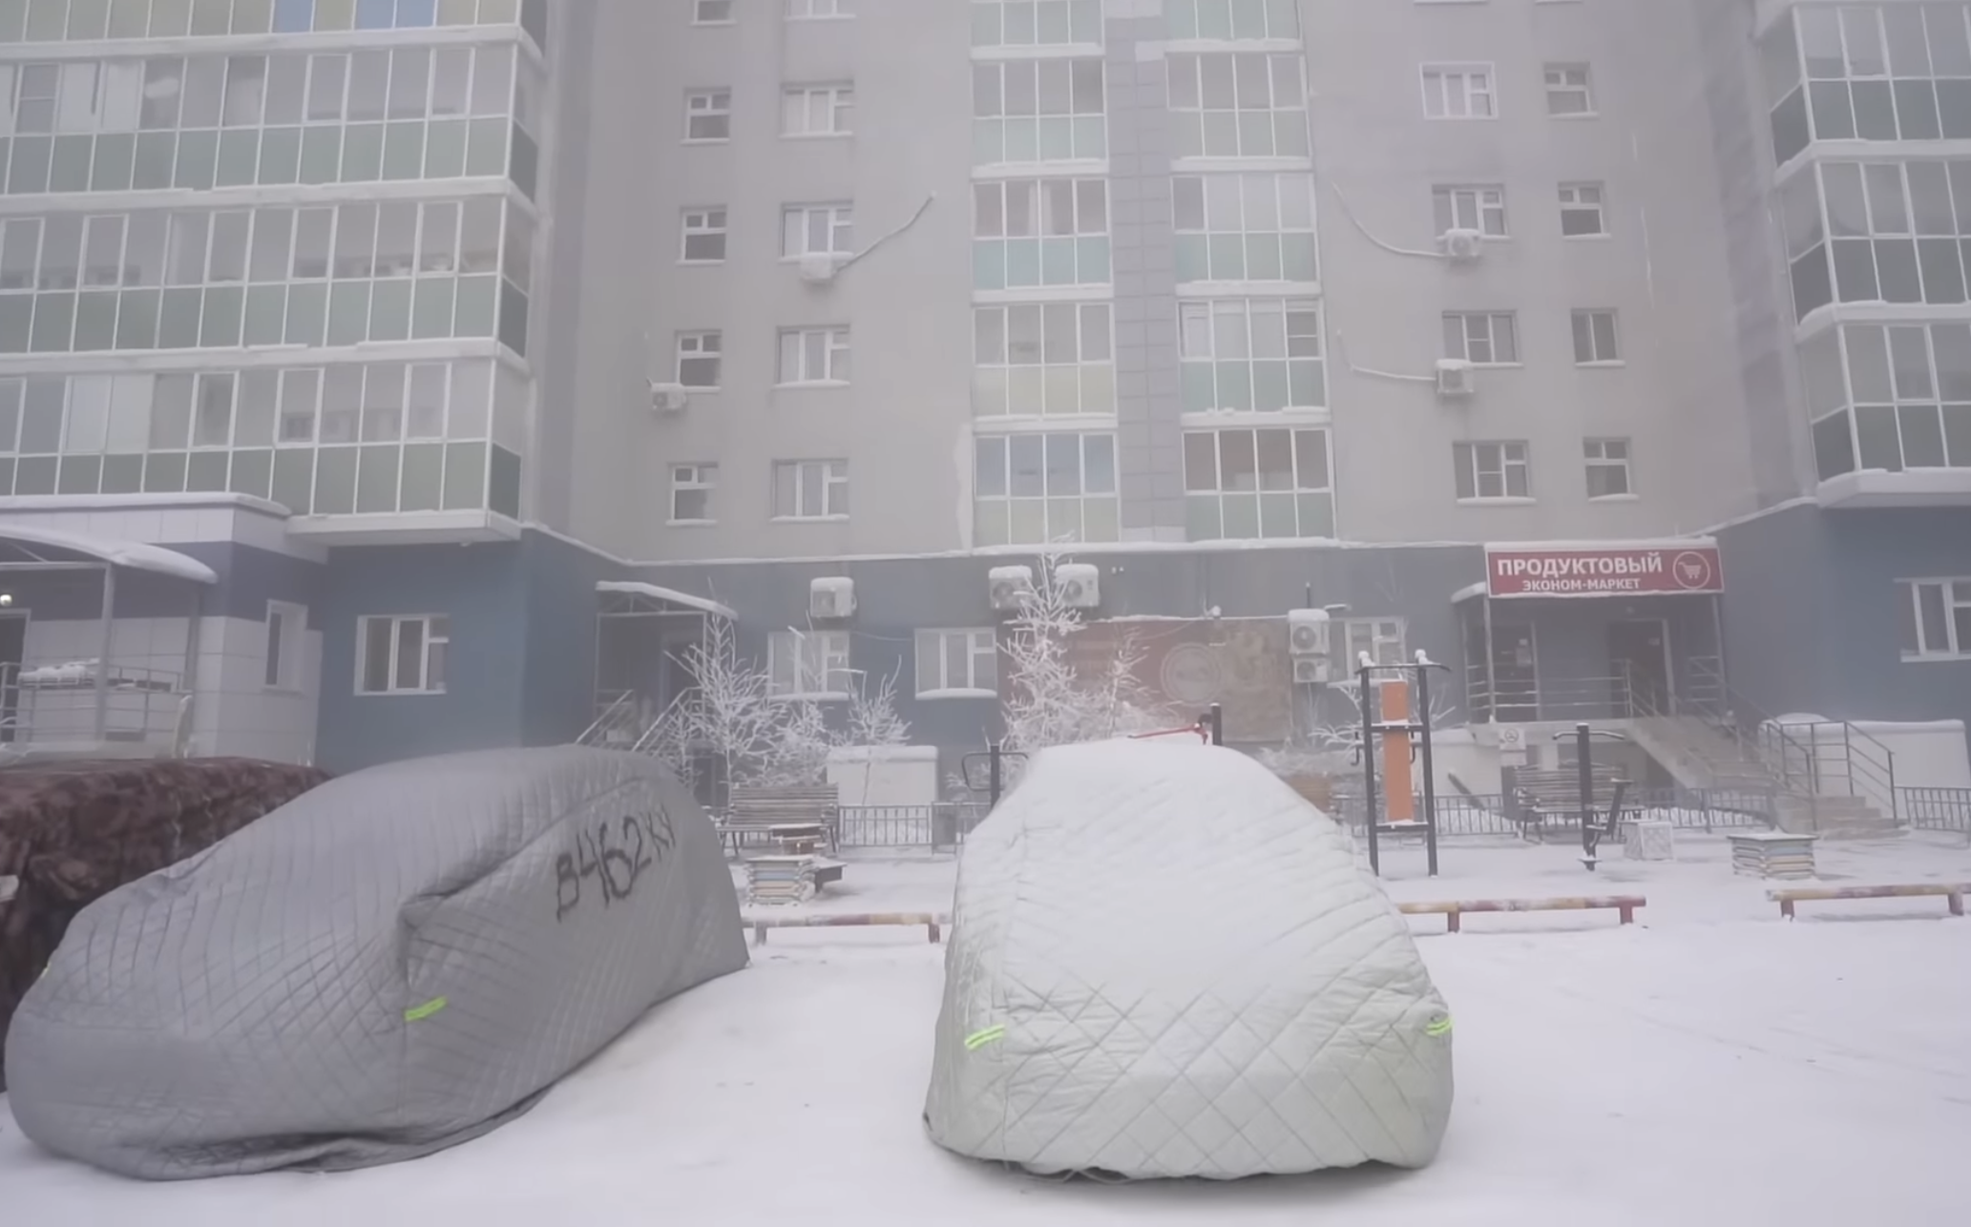

Human inhabitants in cold regions
(Nesmith, 2020)

Slide 15
CONCLUSION
Cold regions are unique and captivating parts of our planet that give us a glimpse of the marvels of nature’s adaptability and the resilience of life in the face of extreme conditions.

Slide 16
references
Nesmith, M., & Nesmith, M. (2020). Winter Survival Tips From People Who Live in Cold-Ass Climates. Retrieved from: https://repeller.com/how-to-survive-winter-weather-from-people-who-live-in-cold-places/
Yung, C. (2007), Why is the equator very hot and the poles very cold?. Hong Kong Observatory. The Government of the Hong Kong Special Administration Region. Retrieved from: www.hko.gov/education/edu06nature/ele_srad_e.

